Slide 1
English 10
Final Exam Review

Slide 2
Details
73 questions, multiple choice, matching.
Scantron – bring a pencil!

Slide 3
Know your vocab roots!
roots
meaning

Slide 4
Connotation
Connotation is the added meaning a word or phrase has that is not part of its definition
For example, “kicked the bucket” is negative; “passed away” is positive.

Slide 5
Attention Getters
Dialogue
Anecdote (brief story)
Quote
Shocking statistic
Question
Unusual statement

Slide 6
Conflict
External conflict:
Character vs. some outside person or things
Internal conflict: Character struggling within him/herself, usually to make a choice

Slide 7
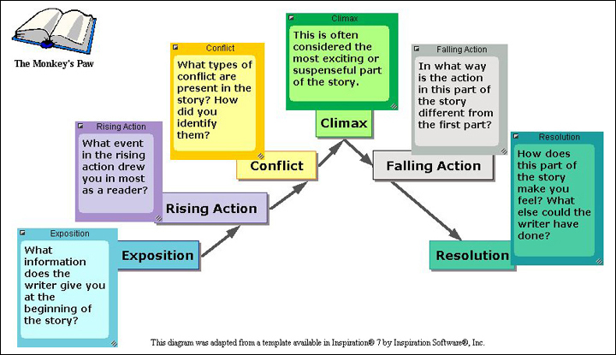
Plot Structure

Slide 8
Persuasive Techniques
Plain folks
Facts and figures
Appeal to tradition
Bandwagon
Patriotism
one in which the speaker presents him or herself as an Average Joe, a common person who can understand and empathize with a listener's concerns
Self explanatory
deemed correct on the basis that it correlates with some past or present tradition.
Everybody’s doing it!
If you love your country, you’ll like this.

Slide 9
Using Quotes in your Writing
Review the handout given to you about how to use non-dialogue quotes in your writing. You will be allowed to use this on the final.

Slide 10
Literature Terms
Terms to know
meanings
Simile
Metaphor
Personification
Symbol
Narrative
Alliteration
Foreshadowing
Theme
Imagery
plot
Compare using like or as
Compare unlike things
Human verb, non human noun
Something stands for something else.
Writing that tells a story
Repetition of sounds in words
Clues about later events in a story
Message, lesson of story
Images and details of 5 senses
Series of events that make a story.

Slide 11
Idioms
Definition
Examples
A figure of speech whose literal translation makes no sense.
It was raining cats and dogs.
He broke her heart.

Slide 12
Nouns
Which of the following red words is not a noun?
Of all of the foods that I enjoy, pizza is at the top of my list.
Running long distances, even in the cold weather, helps me to shut off my brain.

